Slide 1


Day 16
Math24 (Differential Equations)
Ch 4.2 Homogeneous Equations with Constant Coefficient; Higher Order (Page 228-236)
Elementary Differential Equations and Boundary Value Problems, 10th edition, by William E. Boyce and Richard C. DiPrima, ©2013 by John Wiley & Sons, Inc.

Slide 2
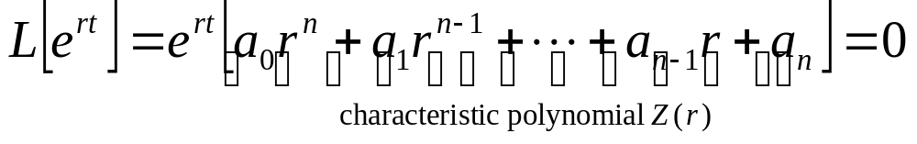

Consider the nth order linear homogeneous differential equation with constant, real coefficients:
As with second order linear equations with constant coefficients, y = e^{rt} is a solution for values of r that make characteristic polynomial Z(r) zero:
By the fundamental theorem of algebra, a polynomial of degree n has n roots r₁, r₂, …, r_{n}, and hence

Slide 3
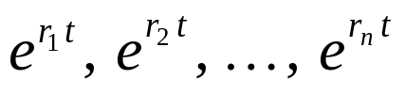
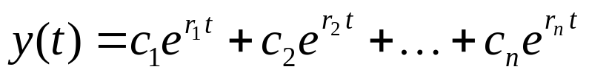
Real and Unequal Roots
If roots of characteristic polynomial Z(r) are real and unequal, then there are n distinct solutions of the differential equation:
If these functions are linearly independent, then general solution of differential equation is
The Wronskian can be used to determine linear independence of solutions.

Slide 4

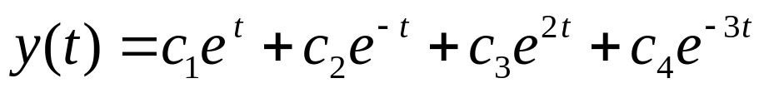
Example 1: Distinct Real Roots (1 of 3)
Consider the initial value problem
Assuming exponential soln leads to characteristic equation:
Thus the general solution is

Slide 5
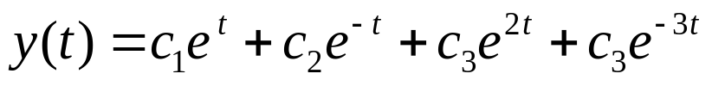




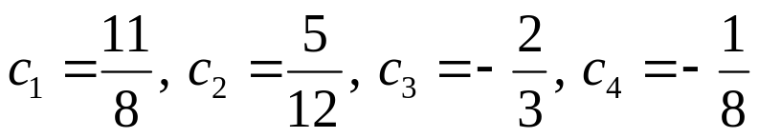
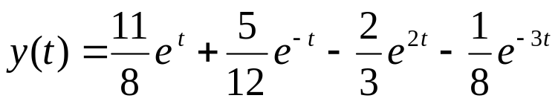
Example 1: Solution (2 of 3)
The initial conditions
yield
Solving,
Hence

Slide 6
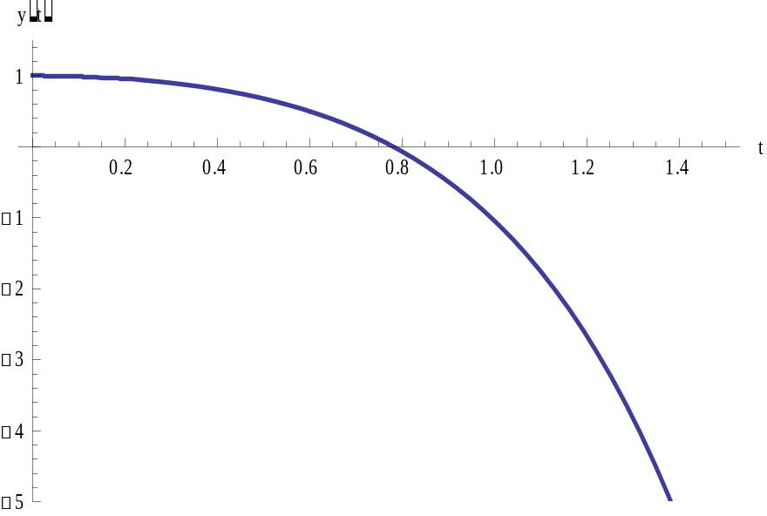
Example 1: Graph of Solution (3 of 3)
The graph of the solution is given below. Note the effect of the largest root of the characteristic equation.

Slide 7



Complex Roots
If the characteristic polynomial Z(r) has complex roots, then they must occur in conjugate pairs, λ ± iμ.
Note that not all the roots need be complex.
Solutions corresponding to complex roots have the form
As in Chapter 3.4, we use the real-valued solutions

Slide 8

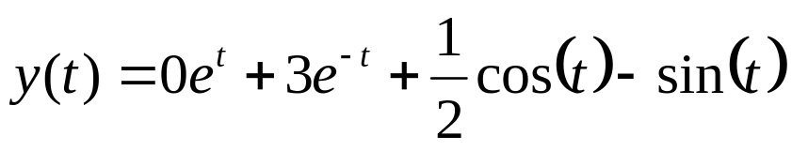
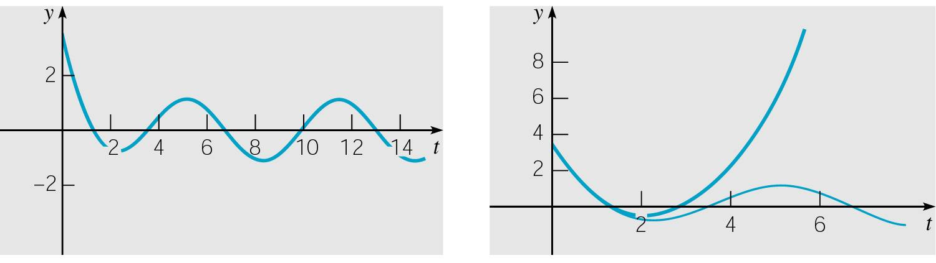
Example 2: Complex Roots (1 of 2)
Consider the initial value problem
Then
The roots are 1, -1, i, -i. Thus the general solution is
Using the initial conditions, we obtain
The graph of solution is given on right.

Slide 9
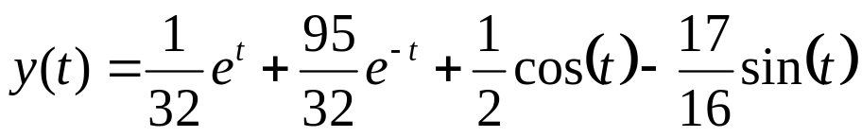
Example 2:
Small Change in an Initial Condition (2 of 2)
Note that if one initial condition is slightly modified, then the solution can change significantly. For example, replace
with
then
The graph of this soln and original soln are given below.

Slide 10


Repeated Roots
Suppose a root r_{k} of characteristic polynomial Z(r) is a repeated root with multiplicty s. Then linearly independent solutions corresponding to this repeated root have the form
If a complex root λ + iμ is repeated s times, then so is its conjugate λ - iμ. There are 2s corresponding linearly independent solns, derived from real and imaginary parts of
or

Slide 11

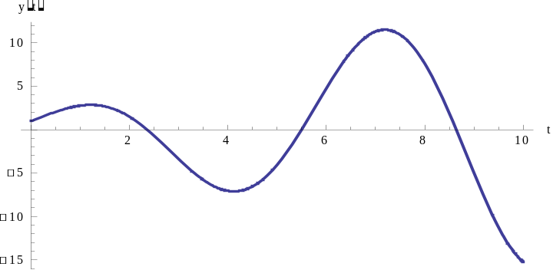
Example 4: Repeated Roots
Consider the equation
Then
The roots are i, i, -i, -i. Thus the general solution is
Sample Solution: y= (1 + t) Cos t + (1 + t) Sin t

Slide 12



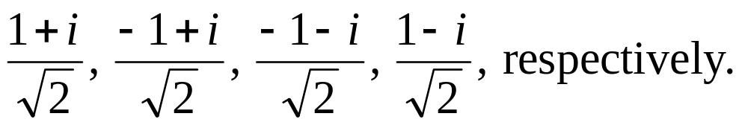
Example 4: Complex Roots of -1 (1 of 2)
For the general solution of , the characteristic equation is .
To solve this equation, we need to use Euler’s equation to find the four 4th roots of -1:
Letting m = 0, 1, 2, and 3, we get the roots:

Slide 13
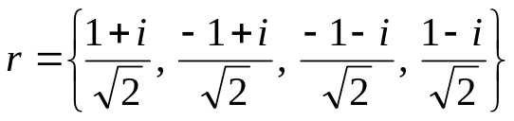

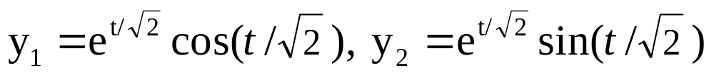
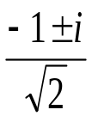
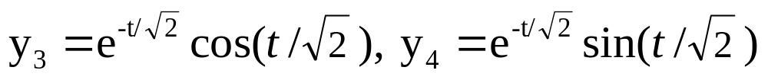

Example 4: Complex Roots of -1 (2 of 2)
Given the four complex roots, extending the ideas from Chapter 4, we can form four linearly independent real solutions.
For the complex conjugate pair , we get the solutions
For the complex conjugate pair , we get the solutions
So the general solution can be written as

